Slide 1


Statistical Analysis of Indore Rainfall
A Dissertation submitted to
Rajiv Gandhi Proudyogiki Vishwavidyalaya
Towards Partial Fulfillment of the Degree of
B.E. (Civil Engineering)
IPS ACADEMY INDORE
INSTITUTE OF ENGINEERING & SCIENCE
CIVIL ENGINEERING DEPARTMENT
Session 2020-2021

Slide 2
GUIDED BY
Assistant Prof.
Mr. Lalitesh Sinha
SUBMITTED BY
Pranjul Sahu
(0808CE171057)

Slide 3
ABSTRACT
Rainfall is a prime input for various engineering design such as hydraulic structures, bridges and culverts, canals, storm water sewer and road drainage system.
A rain gauge station located closely in Indore district is selected for statistical analysis where agriculture is the prime occupation. The daily rainfall data for a period of 10 years is used to understand normal rainfall, and Seasonal rainfall of the selected circle headquarters. Further various plotting position formulae available is used to evaluate return period of monthly and annual rainfall.
This analysis will provide useful information for water resources planner, farmers and urban engineers to assess the availability of water and create the storage accordingly.
The mean, standard deviation and coefficient of variation of annual rainfall was calculated to check the rainfall variability.
From the calculated results, the rainfall pattern is found to be erratic. The best fit probability distribution was identified based on the minimum deviation between actual ,estimated values and withdrawal of monsoon results were used for land preparation and sowing.

Slide 4
LITERATURE REVIEW
The analysis was done to determine the annual and monthly rainfall in indore resign.
Determine the variability in annual rainfall
The Work Discussed In this paper focuses of extracting the trend and seasonal patterns of rainfall on a set of selected weather stations.

Slide 5
INTRODUCTION
Rainfall is a main source of water on earth & it has a dramatic effect on agriculture.
Plants get their water with natural Source i.e rainfall.
Hydrological Data helps to predict the rainfall.
With the data probability of occurrences of random parameter can be calculated.
Weibull method ,Gumble Distribution,Normal Distribution etc. methods are useful in calculation of probability of rainfall.

Slide 6
OBJECTIVES
To analysis the annual average rainfall of Indore as per division of rainfall zones (i.e. Depalpur, Sawer, Hatod, Mhow, Indore, Dewas) according to meteorological department.
Select the appropriate Plotting position and Probabilistic methods
To calculate the statistical parameters of average annual rainfall of Indore.

Slide 7
STUDY AREA
The present study is carried out for Indore (Madhya Pradesh, Fig.1). The region has a latitude and longitude of 22°43′0°N 75°50′50°E respectively. It has the highest elevation among major cities of Central India. The Indore Tehsil is divided in to five zones named as Depalpur, Sawer, Hatod, Mhow, Indore, Dewas according to meteorological department.
The daily rainfall data is collected from the Indian Meteorological Department (IMD), Indore station, for a period of 10 years (2009-2019). This data is used for the Yearly, Monthly and Seasonal Rainfall- Probability analysis. Figure 2 presents the historical annual rainfall for the station.

Slide 8
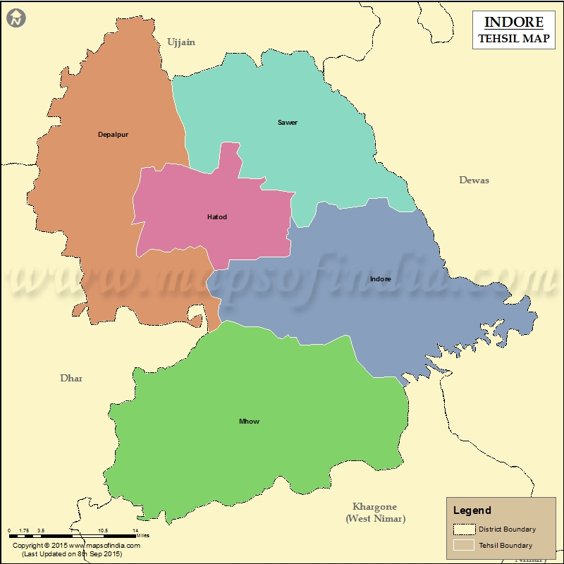
Figure 1. Location map of the study area

Slide 9
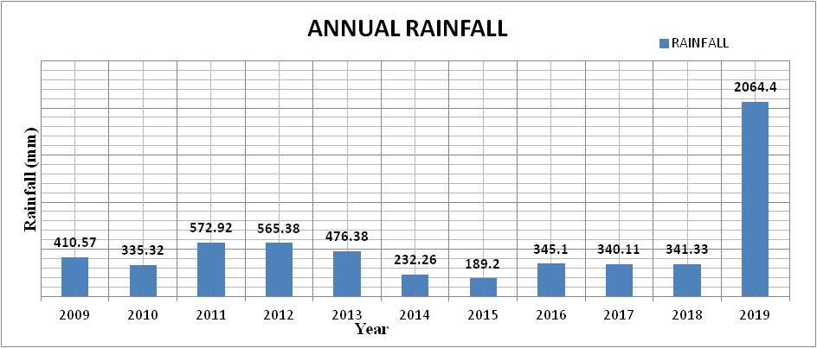
Figure 2. Annual Rainfall of Indore town.

Slide 10
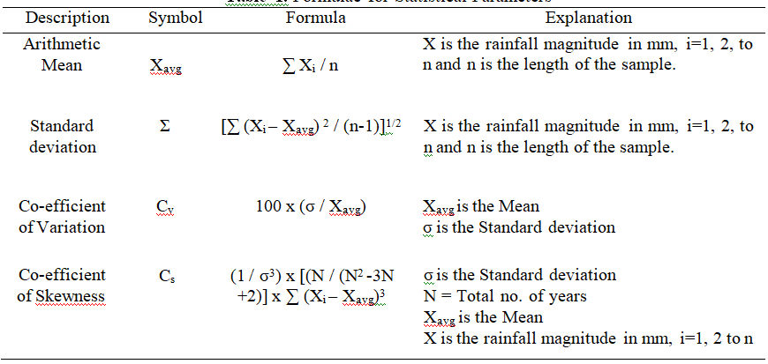
ABOUT THE MODEL
The methodology adopted in this study is Rainfall Statistics &Probability analysis using plotting position & probabilstic method
From the Preliminary study and analysis, variation in results among the plotting position methods is found to be insignificant.
Formulae for Statistical Parameters -

Slide 11
DATA AQUISITION
The annual rainfall data is analyzed and the variation in distribution over the area is studied with the statistical parameters. The best fit distribution method is found using various plotting position and probabilistic methods.
Plotting position and Probabilistic methods
where, m is rank of the data and N = length of the sample (no. of years).
S. No. | Plotting position methods | Probabilistic methods
1 | Weibull method = m/(N+1) | Gumble’s Distribution
2 | California = m/N | Normal Distribution
3 | Hazen = (m-0.5)/N
4 | Chegodayev = (m-0.3)/(N+0.4)
5 | Blom = (m-3/8)(N+1/4)

Slide 12
FORMULEAS OF THE IMPORTANT METHODS
Weibull METHOD
(X) = 𝑚/ (𝑛 + 1)
Where, m and n represents the rank and total number of data used in the analysis
Gumble’s Distribution
P(X) = exp. ((- (a + x)/c) – e – (- (a + x) / c))
a = 0.450055 𝜎 − X_{𝑎𝑣𝑔}and c = 0.7797 𝜎
Where, P(X) is the probability density function for Gumbel method and X_{avg} represents the average rainfall in mm
Normal Distribution
B = 0.5[1 + 0.196854 |Z| + 0.115194 |Z|² + 0.000344 |Z|³ + 0.015927 |Z|
𝑍 = (X − X𝑎𝑣𝑔) / 𝜎, 𝐹 (Xi) = 𝐵fo𝑟𝑍< 0 &𝐹 (Xi) = 1 − 𝐵fo𝑟𝑍> 0
Where,The Probability Density function for the Normal Distribution method is as follows:
(X) = 𝐹 (Xi + 1) – (X) Xi is the rainfall at any instant i = 1,2,3 to n

Slide 13
RESULTS
Calculate expected maximum and minimum rainfall
Maximum Annual Rainfall based on Probabilistic methods
The rainfall data are ranked in descending order and various plotting position and probabilistic methods are applied to determine the return period.
Distribution/Return Period | 50 years (x) in mm | 100 years (x) in mm
NORMAL | 1119.037 | 1173.951
GUMBEL | 1215.274 | 1241.859
Return Period | 10 | 30 | 50 | 100 | 300 | 500
WEIBULL CALIFORNIA | 1019.91 | 1275.35 | 1294.12 | 1155.29 | 1410.73 | 1629.50
HAZEN | 973.83 | 1199.12 | 1103.88 | 1146.02 | 1671.32 | 1776.07
CHEGODAYEV | 994.26 | 1233.04 | 1144.06 | 1494.71 | 1533.48 | 1644.50
BLOM | 987.04 | 1221.06 | 1229.88 | 1277.53 | 1611.56 | 1820.38
AVERAGE MAX RAINFALL | 993.76 | 1232.14 | 1192.99 | 1268.39 | 1556.77 | 1717.61

Slide 14
Statistical Parameters for Annual Rainfall Analysis
Description | Symbol | Formula | Result
Arthematic Mean | Xavg | ∑ Xi / n | 533.9
Standard Deviation | ∑ | Σ [∑ (Xi – Xavg) 2 / (n-1)]1/2 | 521.822
Co-Efficient Of Variation | Cv | 100 x (σ / Xavg) | 97.7366
Co-Efficient Of Skewness | Ca | (1 / σ3) x [(N / (N2 -3N +2)] x ∑ (Xi – Xavg)3 | 2.9928

Slide 15
Average effective rainfall for 10 years
Sr.no | Year | Average Annual Rainfall (mm)
1 | 2009 | 410.57
2 | 2010 | 335.32
3 | 2011 | 572.92
4 | 2012 | 565.38
5 | 2013 | 476.38
6 | 2014 | 232.26
7 | 2015 | 189.2
8 | 2016 | 345.1
9 | 2017 | 340.11
10 | 2018 | 341.33
11 | 2019 | 2064.4

Slide 16
CONCLUSION
From the Rainfall Probability analysis on the Annual rainfall for Indore Region, it is evident that Gumbel Distribution is ascertained as the best distribution for the Annual rainfall data.
The present statistical analysis provides clear picture on rainfall data and it is found that rainfall available in the region is sufficient to carry out cropping.
Conjunctive use of surface water, available rainfall and ground water is essential for better agricultural and irrigation management for this area.
The analysis helps in understanding the rainfall pattern of Indore region and also in efficient crop planning and water availability of the region.

Slide 17
REFERENCE
Suchit Kumar Rai, Sunil Kumar, Arvind Kumar Rai, Satyapriya and Dana Ram Palsaniya 2014 Climate Change Variability and Rainfall Probability for Crop Planning in Few Districts of Central India. Atmos. Climate Sci. 4 394-403.
Nyatuame M, Owusu-Gyimah V and Ampiaw F 2014 Statistical Analysis of Rainfall Trend for Volta Region in Ghana. Int. J. Atmos. Sci. 67(2) 1-11.
Rajendran V, Venkatasubramani R and Vijayakumar G 2016 Rainfall variation and frequency analysis study in Dharmapuri district (India). Indian J. Geo. Mar. Sci. 45(11) 1560-5.
INDIA METEOROLOGICAL DEPARTMENT. Ministry of Earth Sciences. Government of India.

Slide 18
THANK YOU

